Slide 1
Identify pCSM loci
×
√
×
×
Model assessment
Get putative CSM loci
Cell1
Cell2

Slide 2
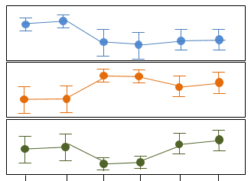
Co-methylation analysis
1
Module1
0
1
Methylation level
Module2
0
1
Module3
0
Samples
Eigen-loci extraction per module
Module1
1
Methylation
level
0
Samples
Module2
…

